Slide 1

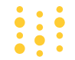
Weights & Biases
Eddie
Bipul

Slide 2
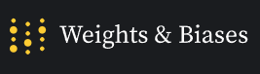
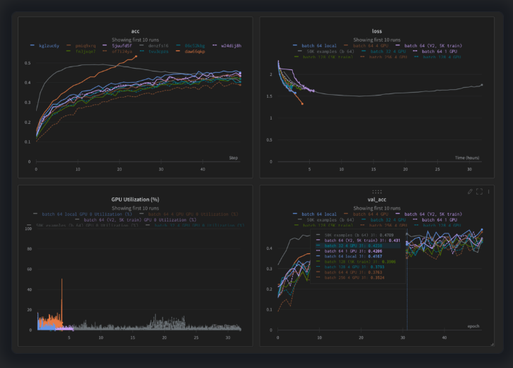
Outline
Story
What is W&B?
Pros, Cons, Competition
How to get started
Understanding important segments of code
Demo

Slide 3
Story
Co-Founded by Lukas Biewald and Chris Van Pelt
Used now by OpenAI, NVIDIA, and Co:here.

Slide 4
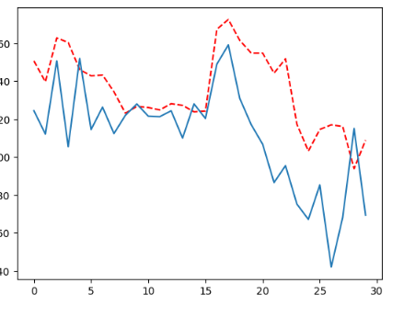
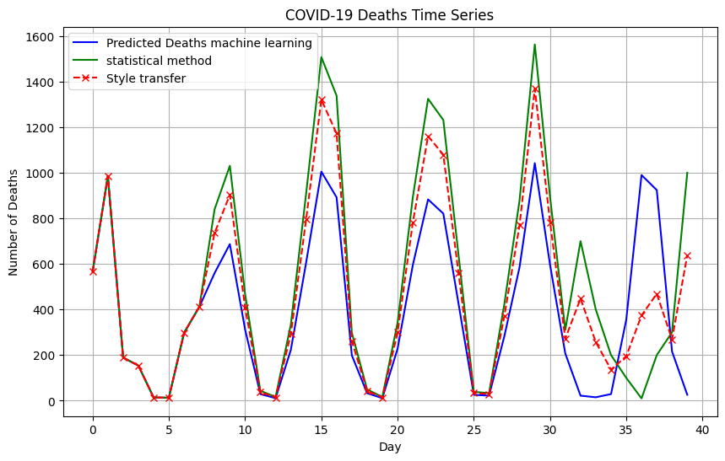
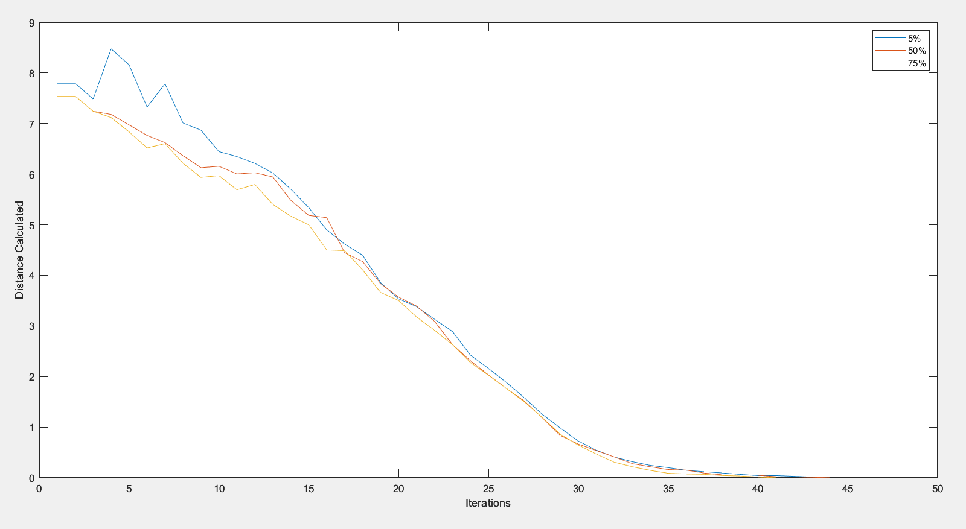
Story- The Problem
Machine learning professionals do not have a system of record for their experiments
No Style Consistency
Lacking Data Labeling
No Means of Proper Storage
No other data

Slide 5
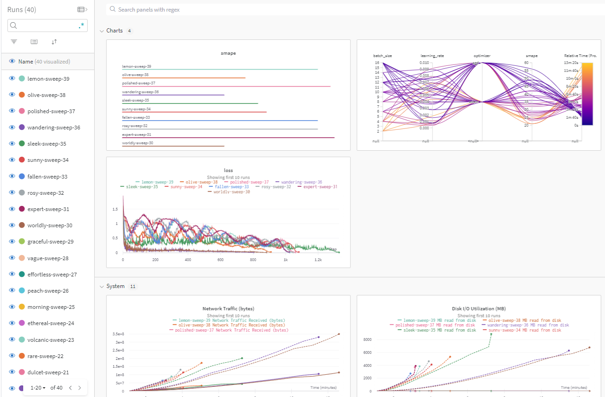
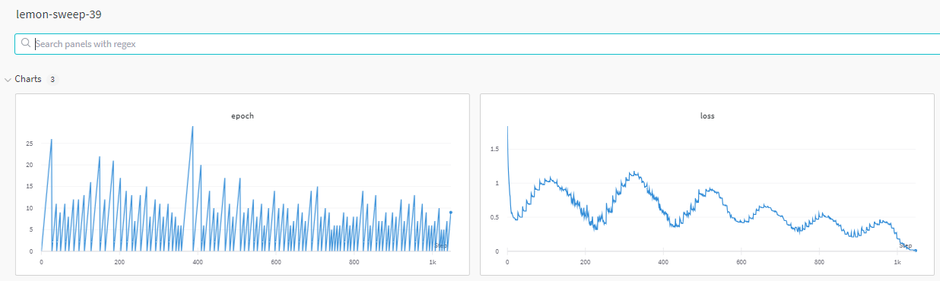
Story- The Solution
Machine learning professionals do not have a system of record for their experiments
Style Consistency
Data Labeling
Proper Storage
All data stored

Slide 6
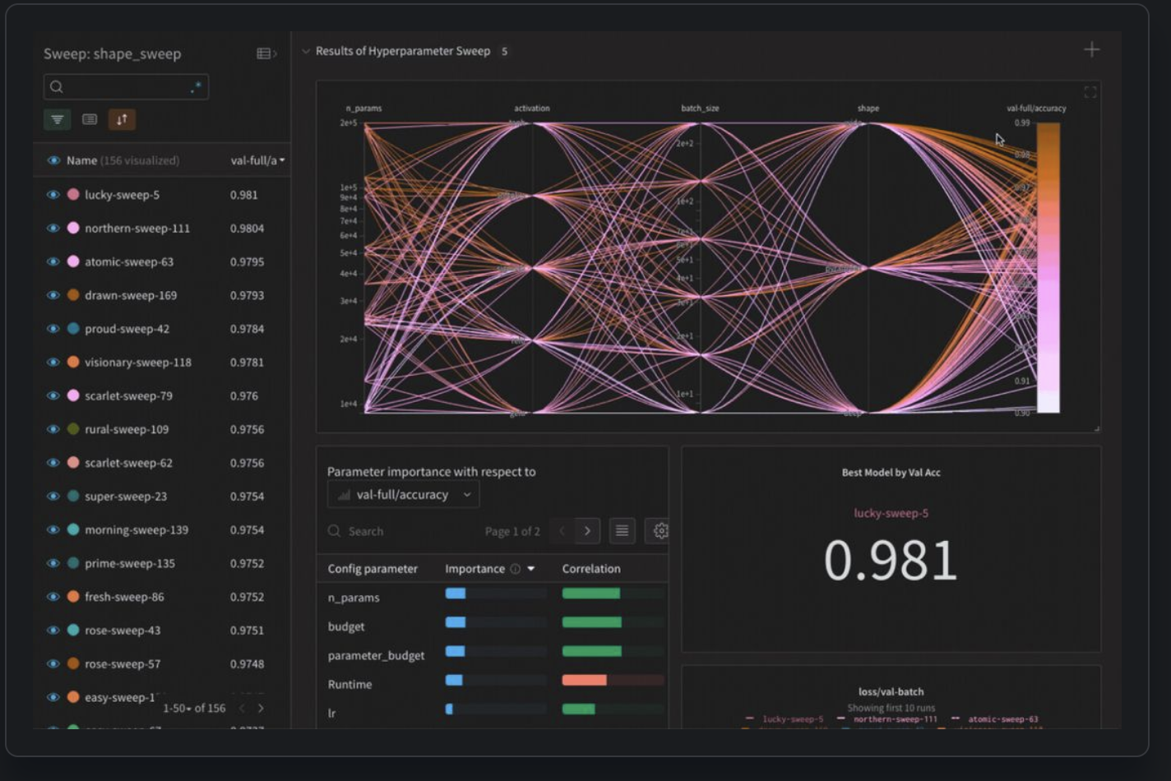
Intro into W&B
What is W&B?
Machine Learning platform for developers to build better models faster.
Tracks model performance
Visualizes the model's learning process
Compares different models and their performance metrics
Collaborates with others by sharing experiments and results.

Slide 7
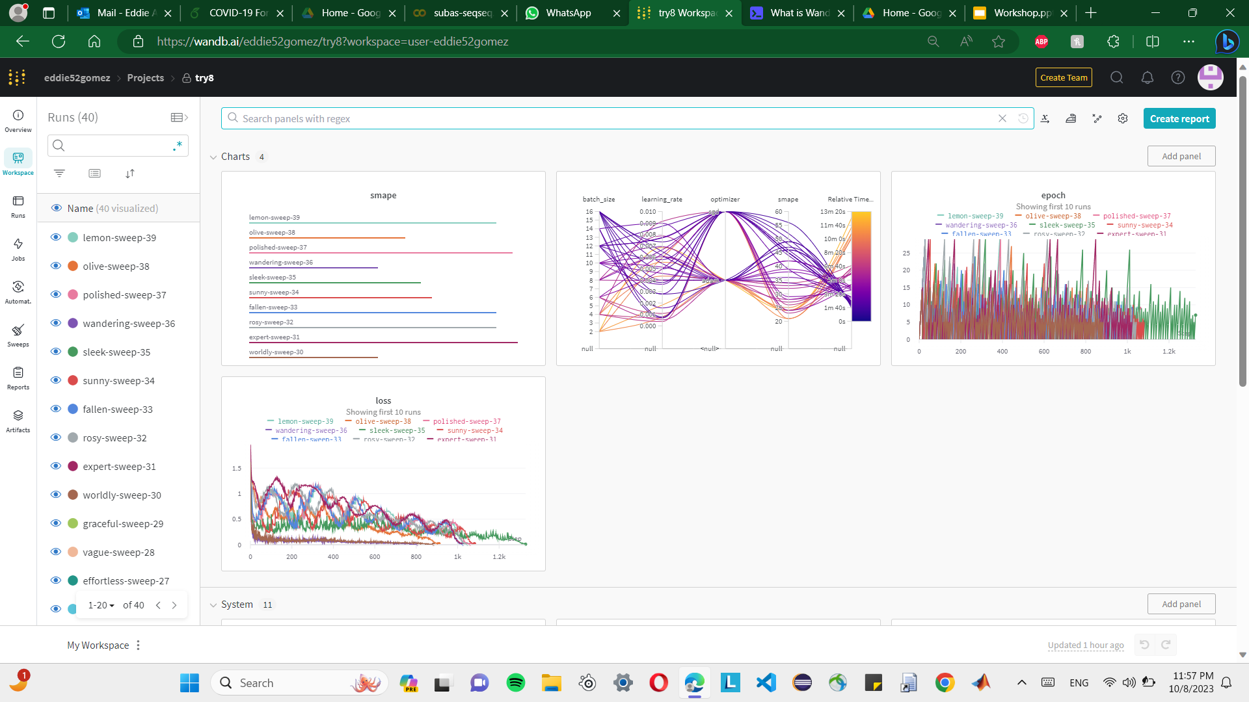
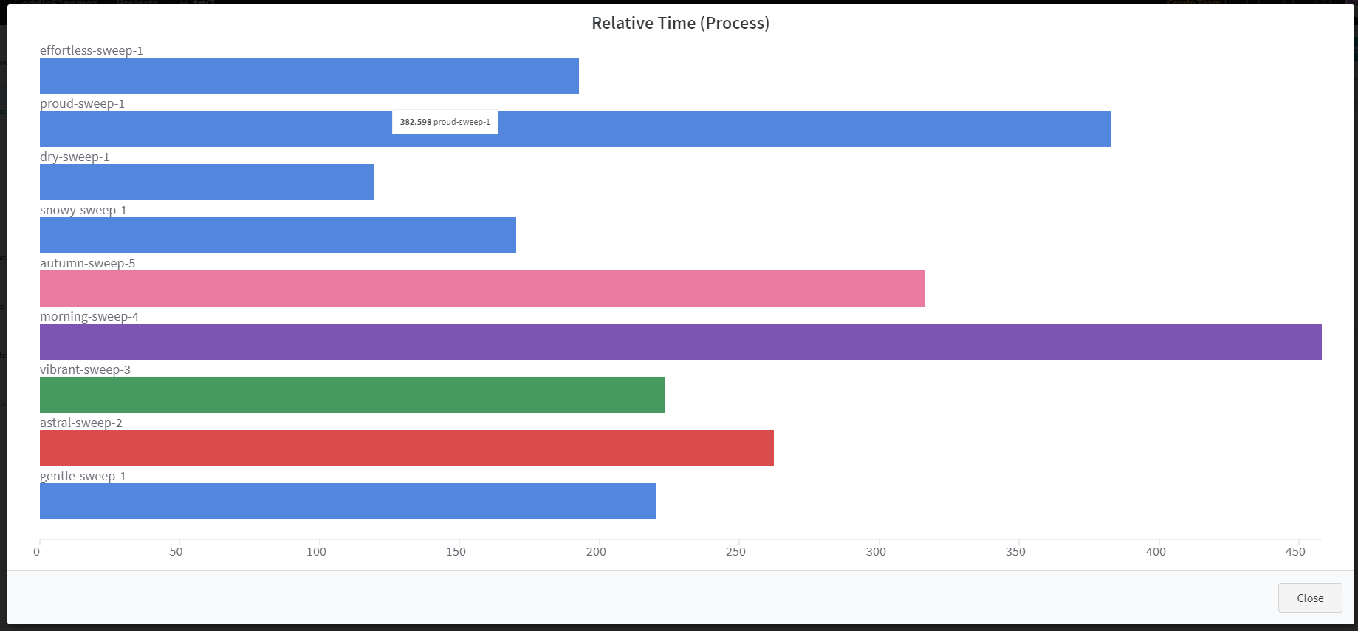
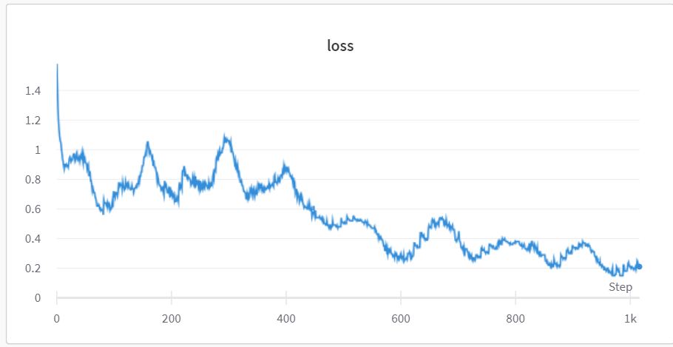
Tracks model performance
You can track accuracy, loss, and any other evaluation metrics you want!
Here we tracked loss, smape, and time to train

Slide 8
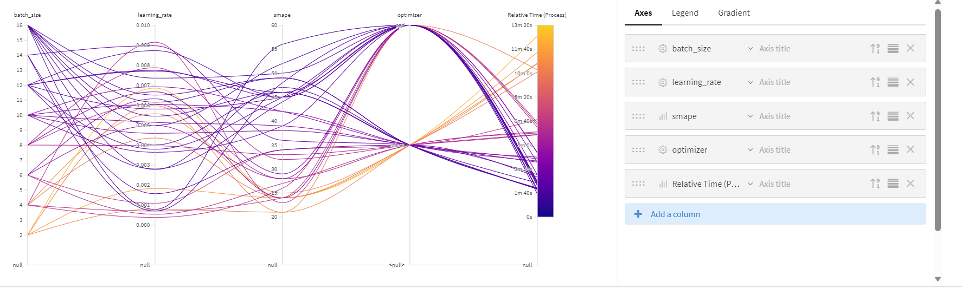
Visualizes the model's learning process
Compare different parameters and let wandb run for a while

Slide 9
Compare different models
(or the same model and its differing performance metrics)

Slide 10
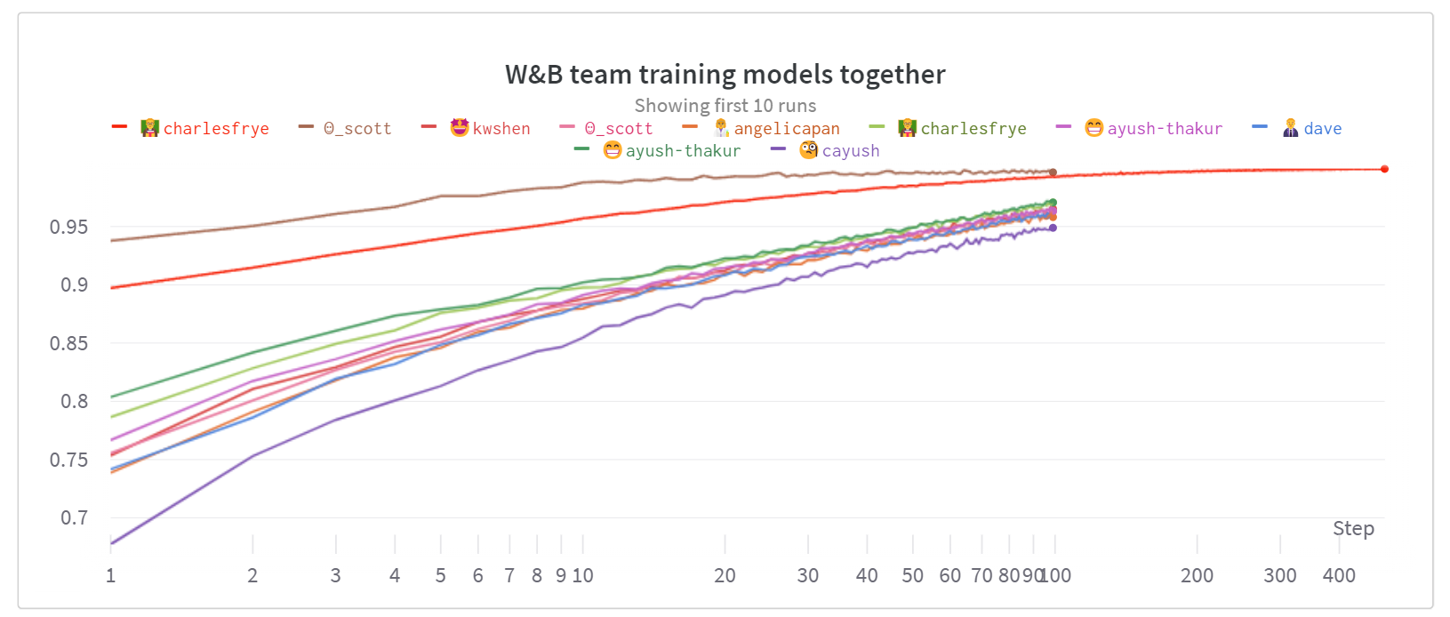
Collaborates with others
(share experiments and results)
Weights and Biases offers a teams option (paid)
It is still easy to share wandb results since they are stored on your online account

Slide 11
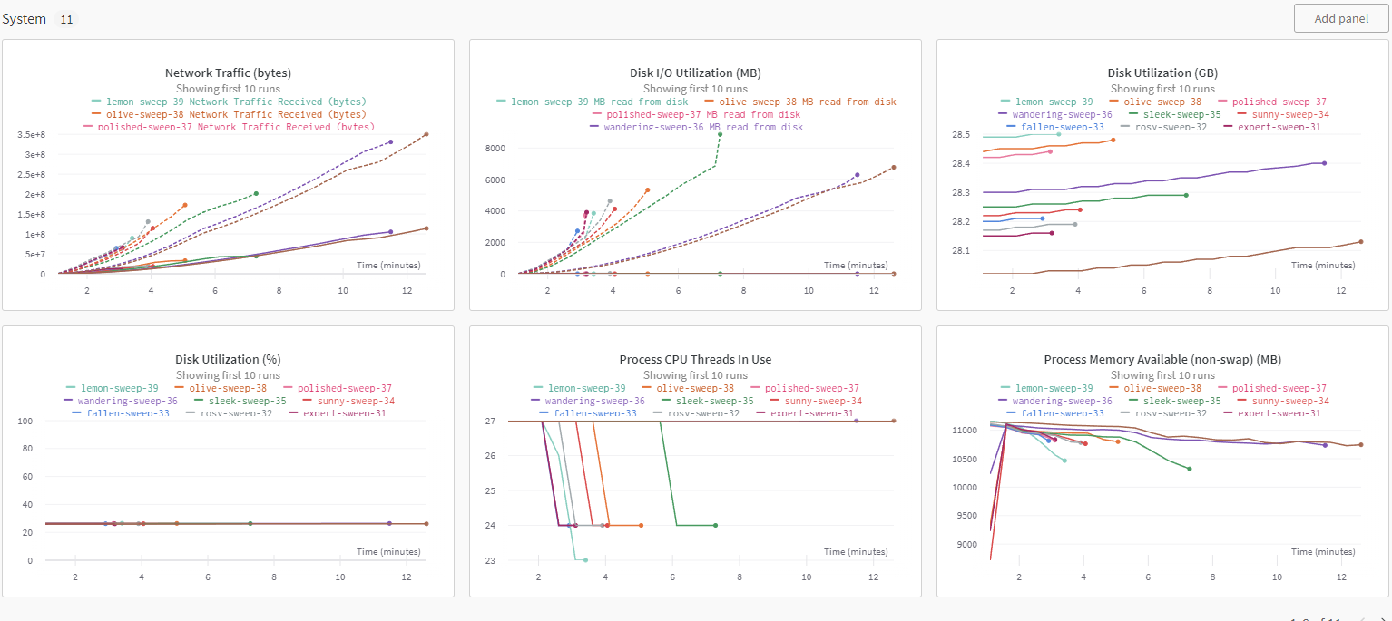
Bonus!
You can keep track of your system too.

Slide 12
Pros, Cons, and Competition
Neptune AI
TensorBoard
ML Flow
Pros
A central, user-friendly and interactive dashboard
Tracking every part of the model training process, visualizing models, and comparing experiments.
Automated hyperparameter tuning with the use of Sweeps
Collaborative reports for teams
Easy integration with frameworks like Tensorflow, Pytorch, Keras, Hugging Face, and more.
Cons:
Teams are paid, more expensive than some competitions.
Preference

Slide 13
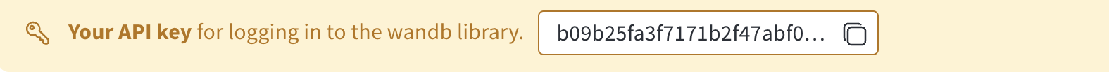
Installation & Get Started
Sign Up for free account at https://wandb.ai/site.
The library is free for personal use but comes with monthly price for teams.
Install the wandb library in Python 3 environment:
pip install wandb
conda install -c conda-forge wandb
Login to W&B Python SDK and provide the API Key
wandb.login()

Slide 14
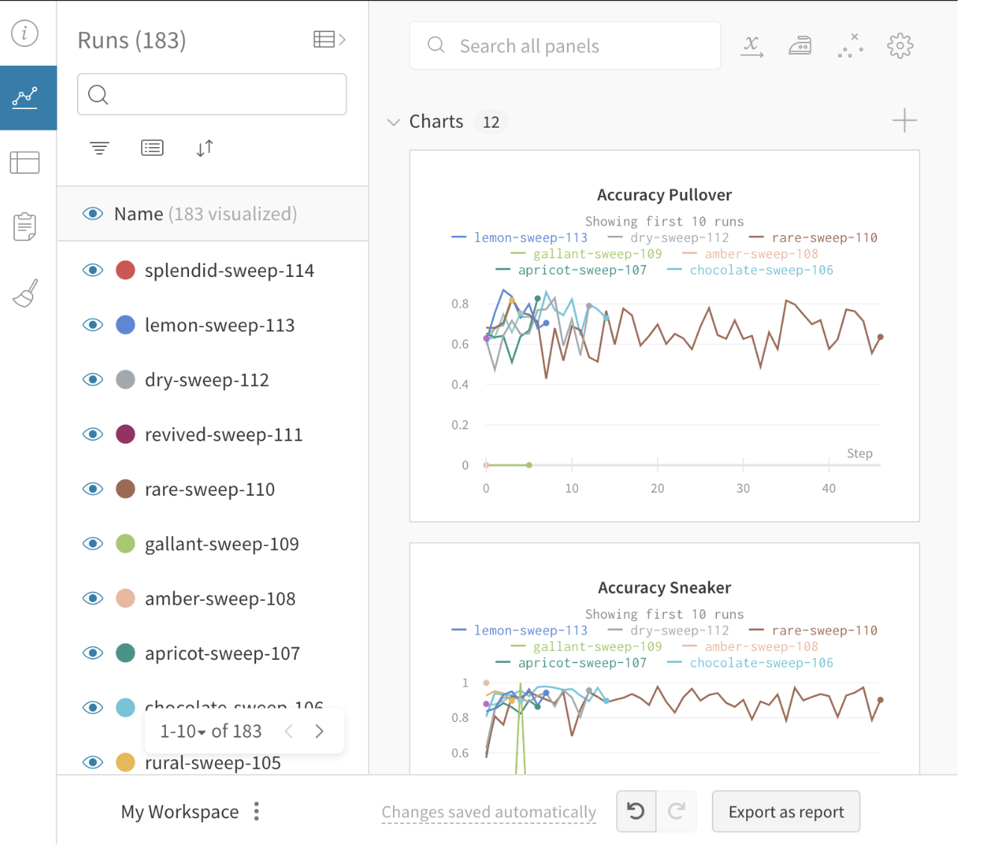
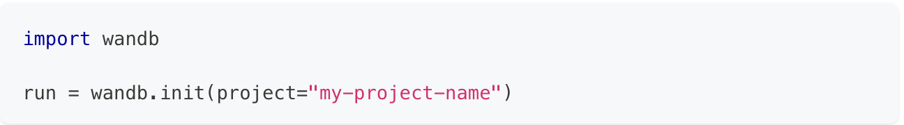
Installation & Get Started
Start a Run and track hyperparameters
What is Run?
A single unit of computation logged by W&B is called a Run.
Atomic element of whole project. Change in hyperparameter or using different model creates new W&B Run.
Create a Run

Slide 15
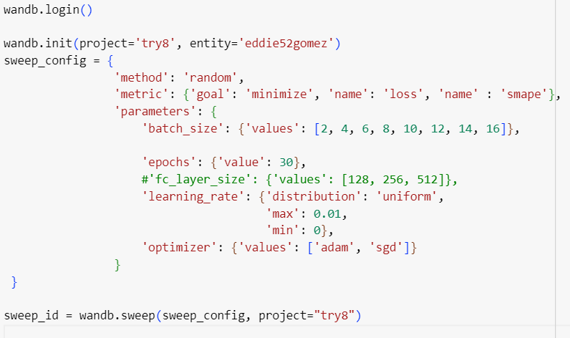
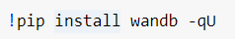
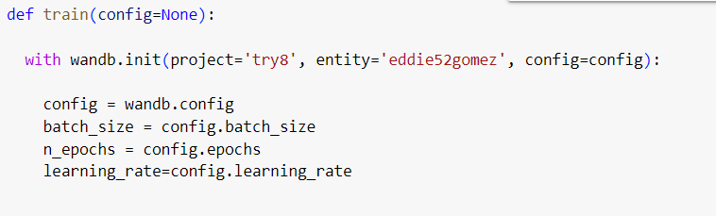
Important Pieces of Code

Slide 16
Demo

Slide 17
Conclusion
We’ve started using weights and biases in our own research.
More details you can find in their documentation, which is very well written.
Many examples are also provided in their Github repository.
It truly is simple to integrate and worth the extra hassle
Questions?

Slide 18
Links / Sources
What is WandB and what is it used for? (educative.io)
About Weights & Biases (wandb.ai)
Weights & Biases, which counts OpenAI as a customer, lands $50M | TechCrunch

